Slide 1
Wayne State University

Slide 2
Doing Business with Wayne State University
Kenneth Doherty
AVP – Procurement & Strategic Sourcing

Slide 3
About Wayne State University
Founded in 1868-155 years in the heart of Detroit
Almost 24,000 students, with one of Michigan’s most diverse student bodies
Midtown Detroit main campus delivers world-class education with 13 schools and colleges
Only urban research university in Michigan-
annual research expenditures of $244 million
https://irda.wayne.edu/quickfactsandreports.

Slide 4
Purchasing’s Roles:
Procurement & Acquisition Authority
Service Provider to Wayne State University Students, Faculty & Staff
Primary point of contact for the Vendor Community
Distribution of Bid Opportunities, via List-Serves, website or e-mail

Slide 5
Buying Assignments:
Organization
Combination of Centralized and Decentralized
By Commodity
Capital Equipment
Printing & Promotionals
Supplies
Service
By Departments, etc.
School of Medicine
Dean of Students
Facilities Planning & Management
Computing & Information Systems

Slide 6
Snapshot of the Items We Buy
Computers, Computer Hardware & Software
Printing & Promotionals
Furniture
Office Supplies
Audio Visual Equipment
Copiers/ Managed Print
Banquet Facilities
Construction
Athletic Equipment
Appliances
Gases
Musical Equipment
Biologicals & Chemicals
Medical & Scientific Equipment
Physical Plante & Equipment

Slide 7
The Buying Process:
The Spot Buy
RFP’s and RFQ’s for Supplies or Services
Strategically Sourced Agreements
Construction Bids
Negotiated Contracts

Slide 8
Thing we consider:
Service, Quality & Price
FOB
Payment Discounts
Terms and Conditions of Sale
Performance Standards/Clauses

Slide 9
Our Website:
Gateway to learning about
Wayne State University Purchasing
and Bid Opportunities
(procurement.wayne.edu)

Slide 10
Our Website:
List of Buyers by Commodity
List of Upcoming RFPs / Bids
Advertised Bid Opportunities
List Serve for regularly bid commodities
New Supplier / Vendor Registration

Slide 11
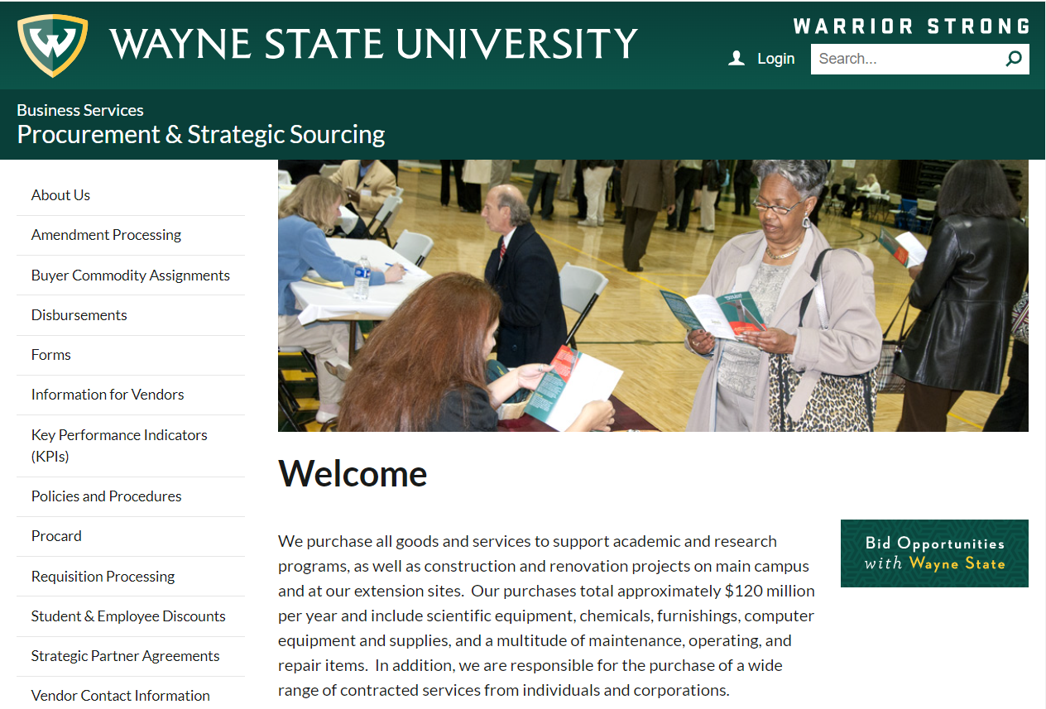
Our Website:
Our Website

Slide 12
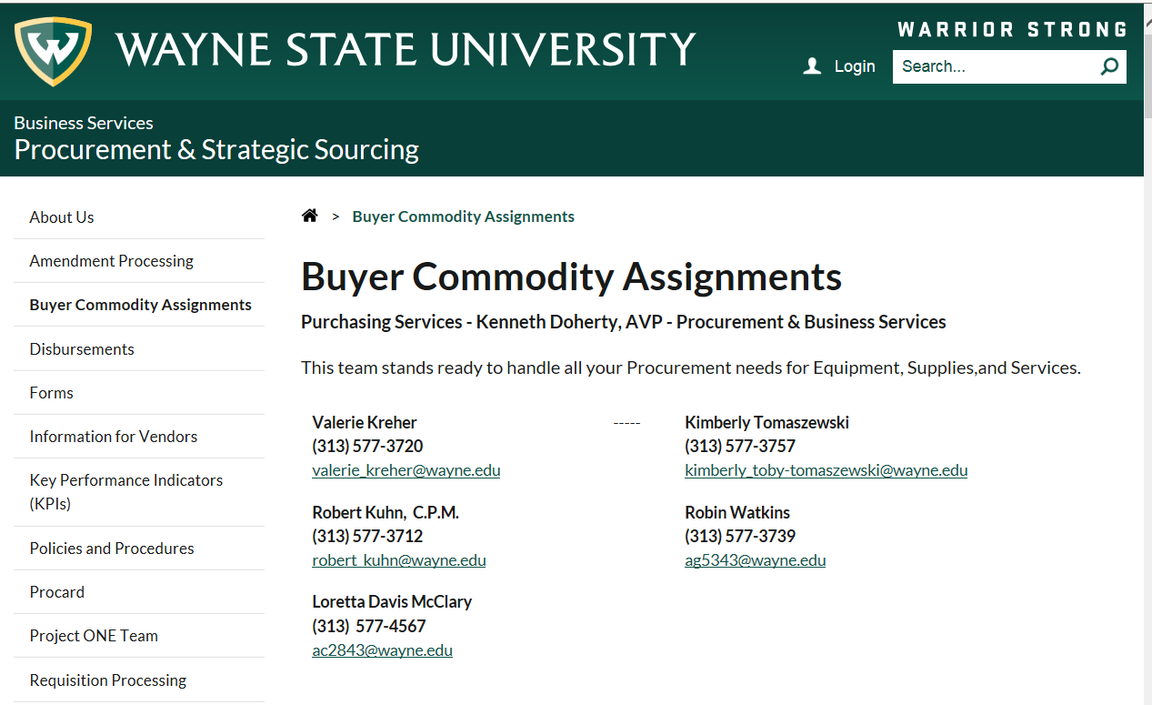
Our Website:
Our Buyers

Slide 13
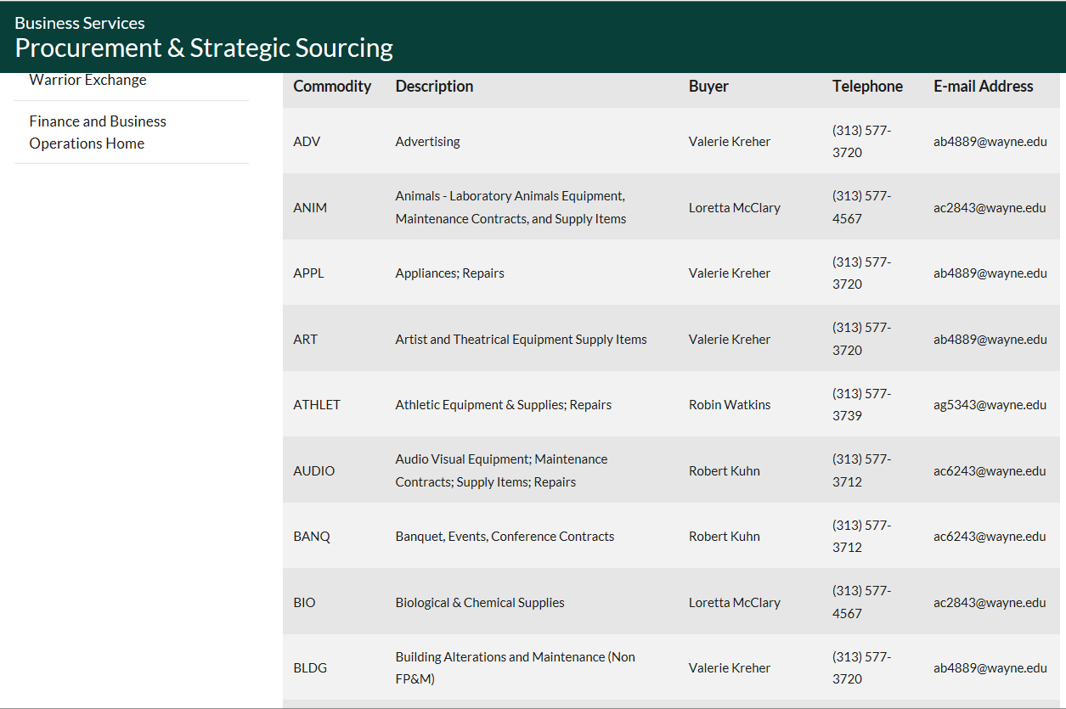
Our Website:
Buyers by Commodity

Slide 14
Our Website:
Advertised Bids

Slide 15
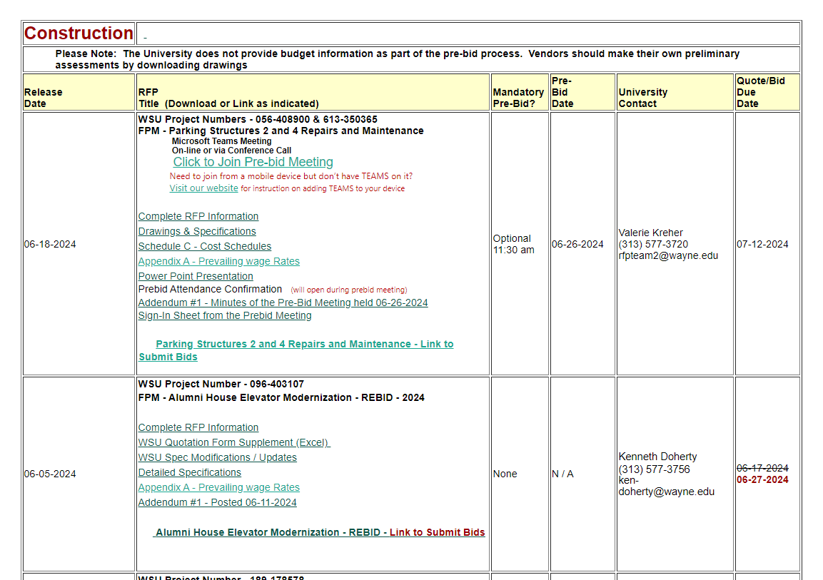
Our Website:
Advertised Bids

Slide 16
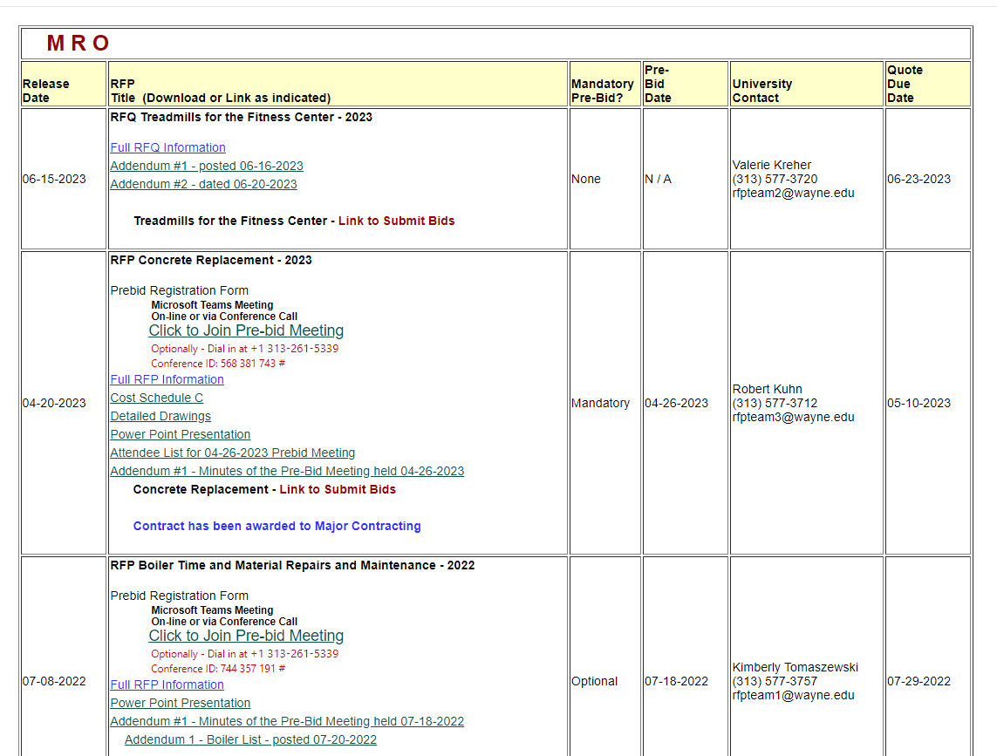
Our Website:
Advertised Bids

Slide 17
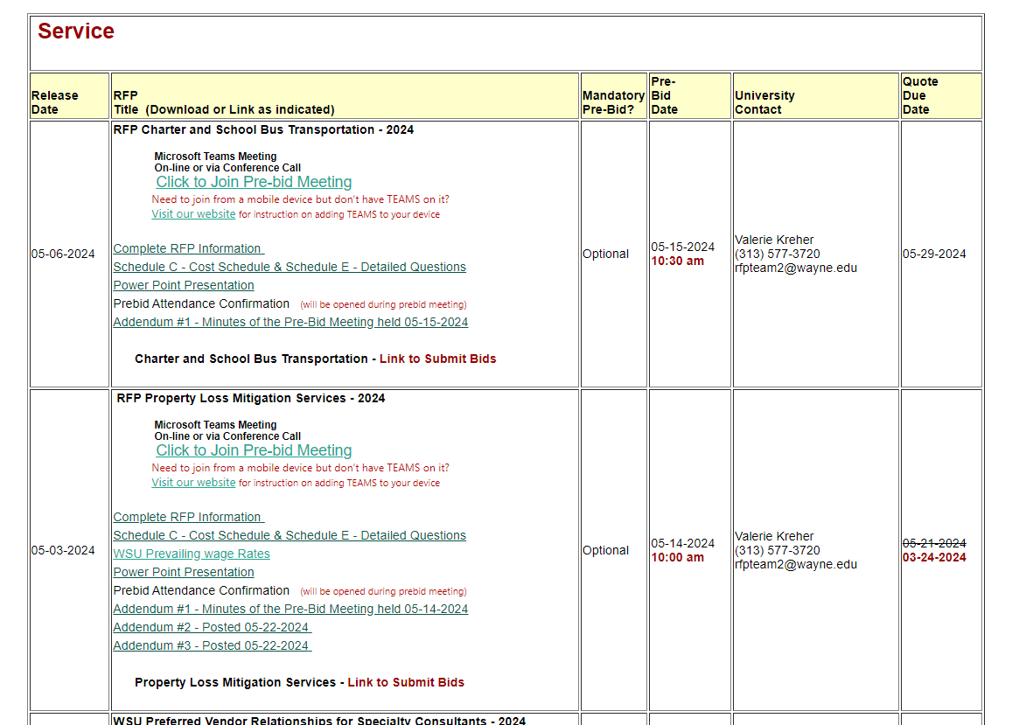
Our Website:
Advertised Bids

Slide 18
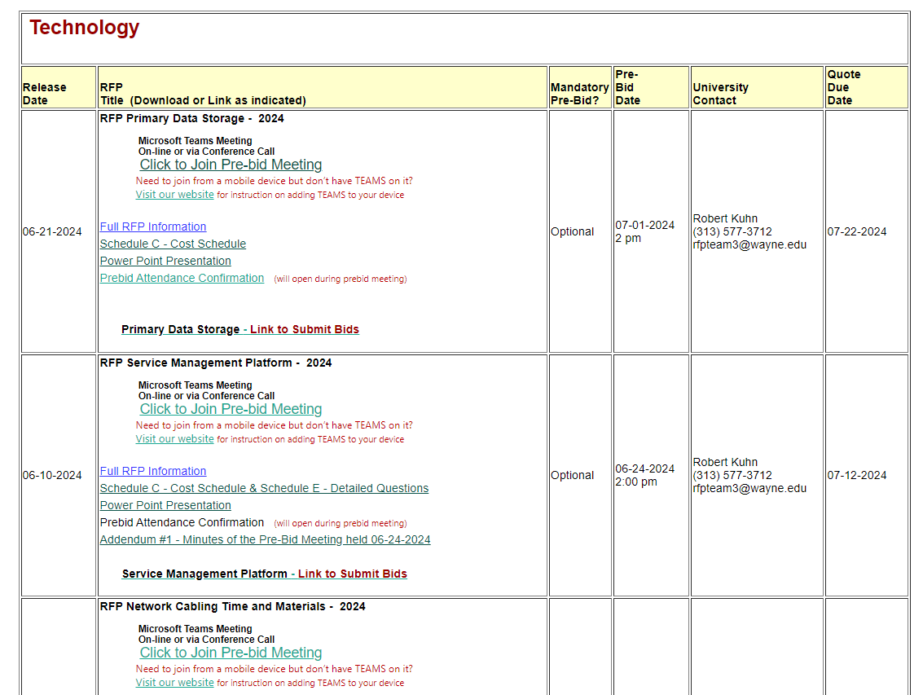
Our Website:
Advertised Bids

Slide 19
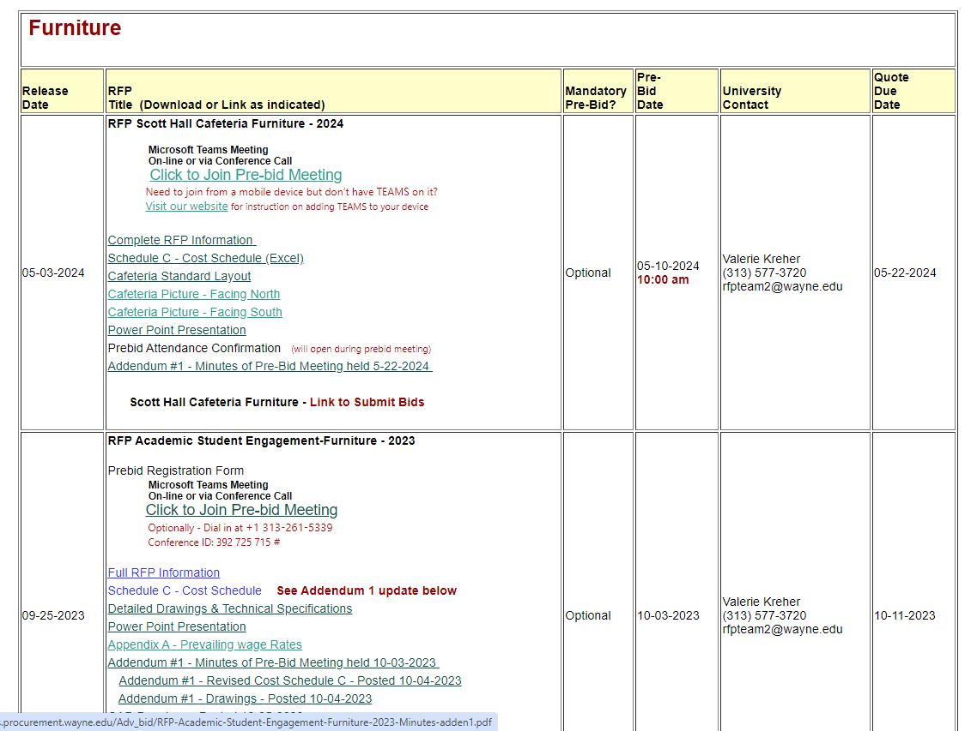
Our Website:
Advertised Bids

Slide 20
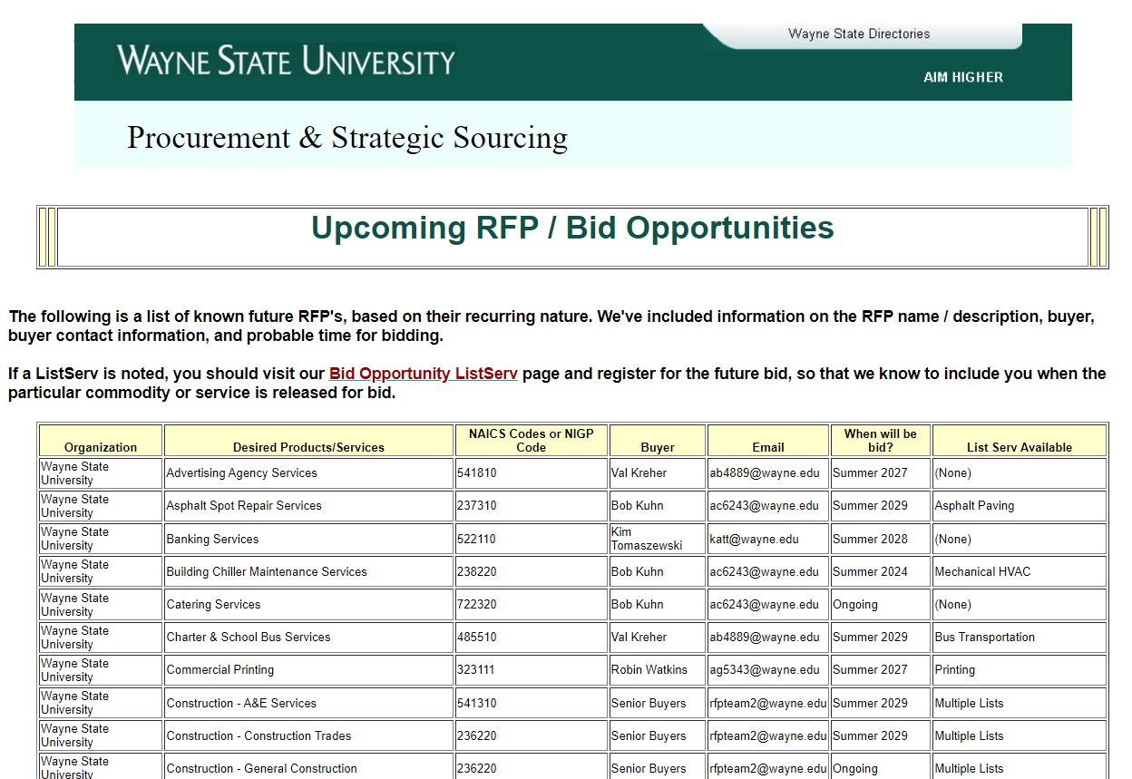
Our Website:
Upcoming RFPs

Slide 21
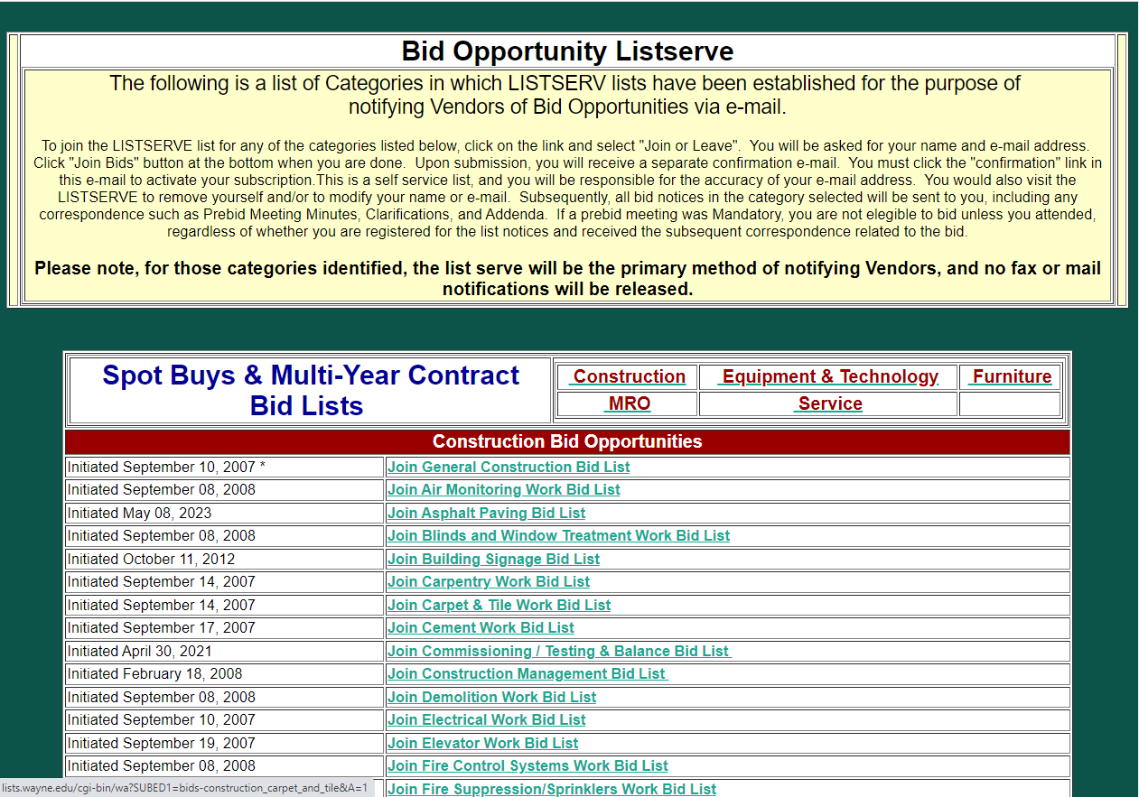
Our Website:
Our ListServ

Slide 22
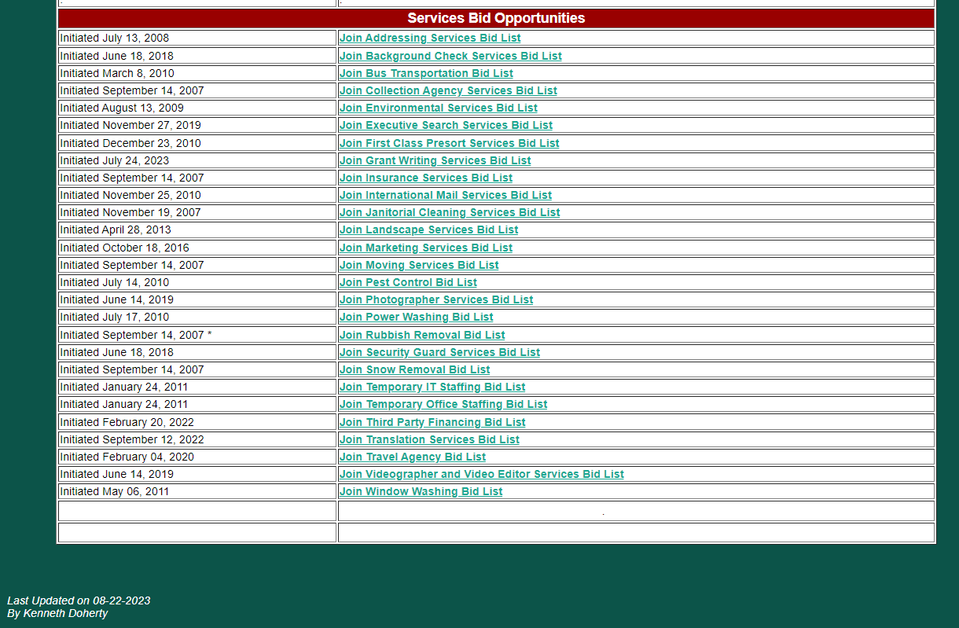
Our Website:
Our ListServ

Slide 23
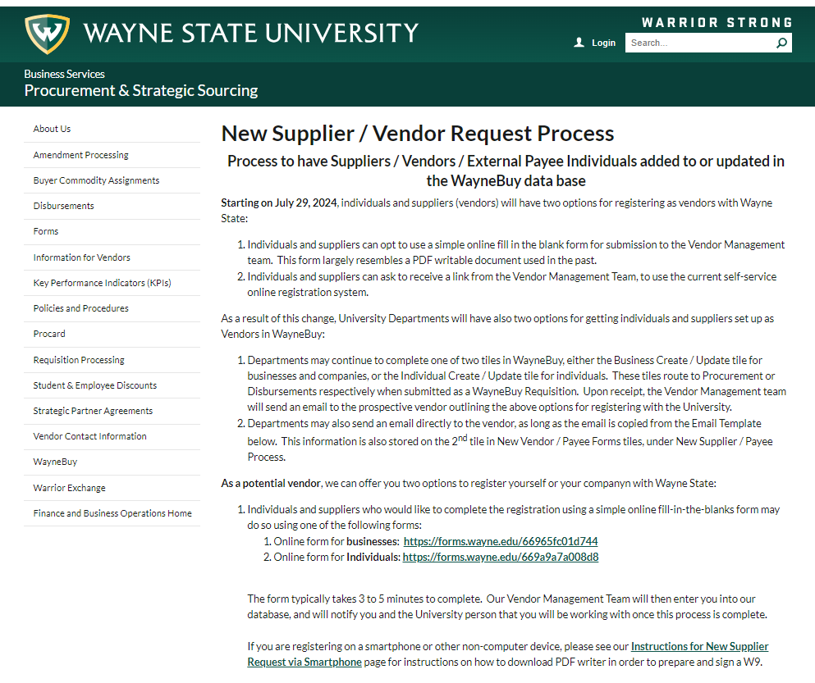
Our Website:
New Supplier Application

Slide 24
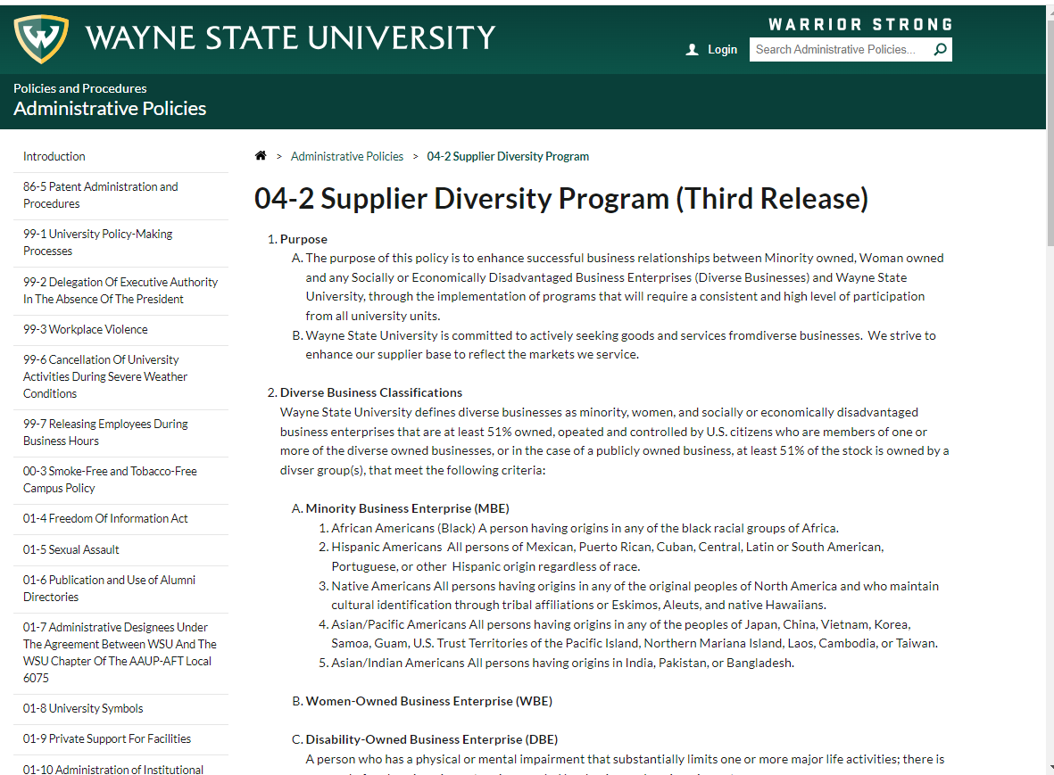
Our Website:
New Supplier Application

Slide 25
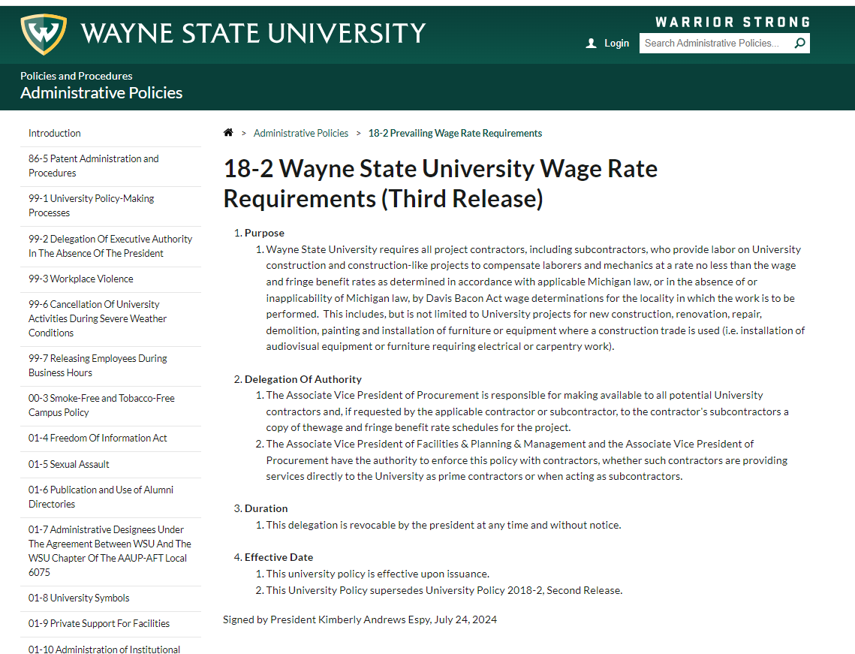
Our Website:
New Supplier Application

Slide 26
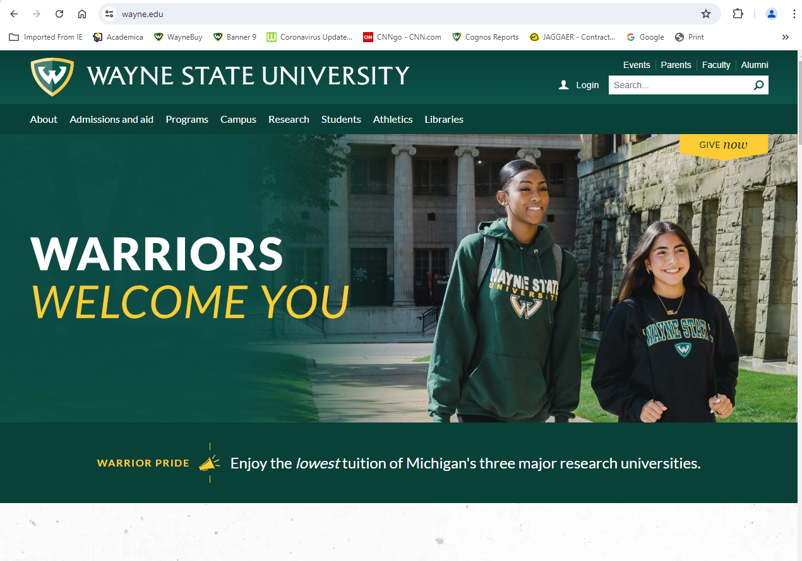
Our Website:
WSU Home Page

Slide 27
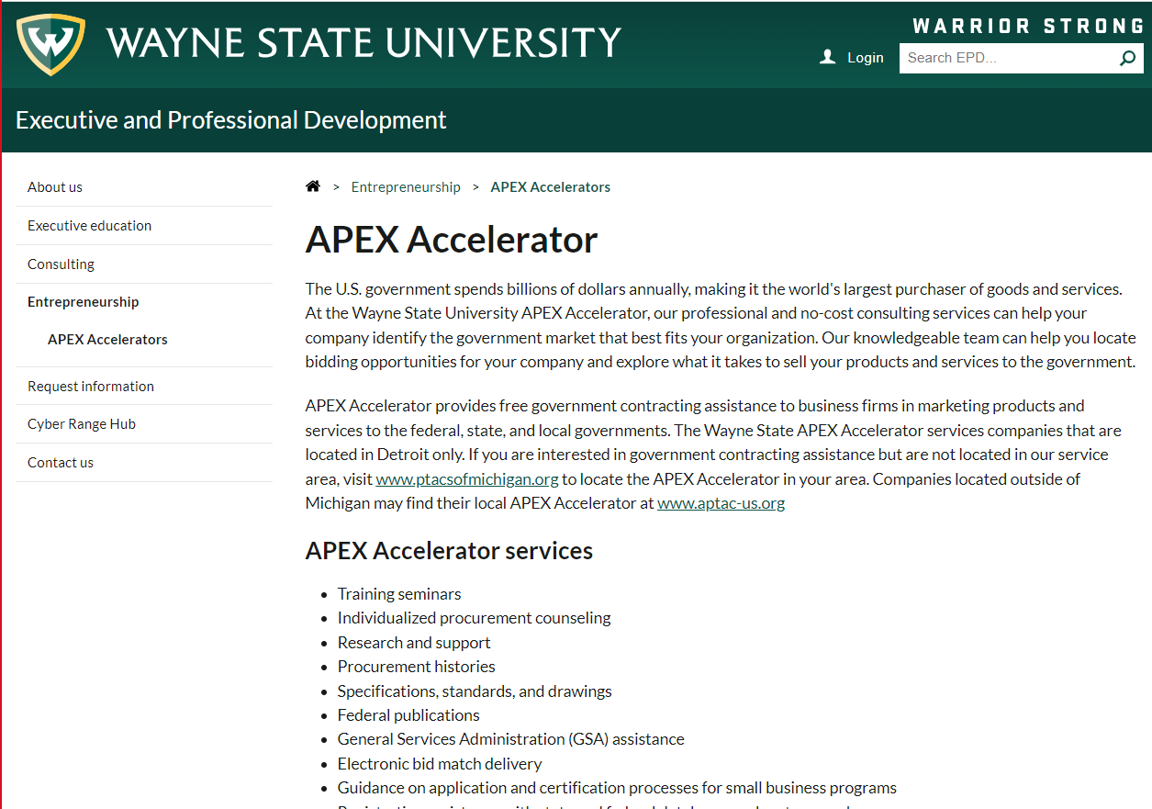
Our Website:
APEX at Wayne State

Slide 28
Wayne State University

