Slide 1

A better way to buy at WSU
February 2012

Slide 2
What is WayneBuy?
WayneBuy is an electronic procure-to-pay system that:
Provides expanded online shopping capability through a single point of access, to multiple vendor websites customized for Wayne State University .
Offers easy access to WSU contract pricing for the experienced department administrator, as well as the casual “shopper”.
Provides customizable form-based requisitioning for specific goods and services.
Dispatches purchase orders electronically to select vendors to expedite delivery to the end user

Slide 3
What is the WayneBuy Platform?
WayneBuy is built upon technology from SciQuest:
Over 100 higher education institutions, representing more than 194 individual campuses, are SciQuest customers.
SciQuest is a market leader in eProcurement software for higher education and research institutions and has consistently achieved a 97% customer satisfaction/renewal rate.
SciQuest customers include:
University of Michigan Notre Dame Northwestern University University of Illinois University of Chicago University of Minnesota | Purdue University Yale Johns Hopkins MIT Harvard And many more…

Slide 4
Why eProcurement
WSU’s peer institutions are utilizing best-in-class eProcurement, with improved customer service and cost savings.
Opportunity to:
  Increase customer satisfaction through
  streamlined processes and pricing.
  Stretch department budgets through
  strategically sourced pricing.
  Leverage spend to negotiate pricing discounts and
  favorable terms.
  Provide one-stop shop when there is a need to purchase specialized items.
Project is part of WSU’s ongoing operational efficiency initiatives.
Today
Rollout
Future

Slide 5
Strategic Sourcing Approach
We are implementing a methodical approach to reducing the total delivered costs of purchased goods and services, while improving quality and service.
Master
Sourcing Plan
Sourcing Organizational
Redesign
Operational
Execution

Slide 6
Benefits
Ease of use
  Online shopping
  Ability to include multiple vendor’s items in a single cart.
  WSU specific catalogs.
  Single point of access to multiple WSU custom vendor websites.
  Simpler screens and expanded features.
Visibility
  Real time order status
  Real time encumbrance of funds.
  Visual workflow and payment status.
  Online history from Requisition to Payment.
  Data export capabilities.
Speed
  Automatic order transmission to select vendors
  Real time processes.
  Ability to copy & create new orders from previous orders, reducing data entry.
  Shortcuts and favorites.
Efficiencies
  Reduced backend reconciliation, ProCard clearing and corrections.
  Delegation of approval process capability, when needed.
  Real time view of where the transaction is in the approval process.
Stretching Your Dollars
  Price savings through on contract spend.
  Improved contract pricing over time.

Slide 7

User Focus and Involvement Throughout the Project
Q4 - 2011 |  |  | Q1 - 2012 |  |  |  | Q2 - 2012 |  |  |  | Q3 - 2012
Needs Analysis
Design and Build
Test
UAT
Pilot
Customer Service
Business Process Transformation
Communication, Town Hall, Ongoing Business Process & System Training
Focus groups to gain understanding business needs, town halls, end user communications
User acceptance testing,
“set up” webinars, and end user training
Colleague support, knowledge sharing
Targeted Go-live
Notes:
- Need exact dates for Prototyping and Focus groups

Slide 8
Extended Project Team
Focus Group The campus voice for business requirements
Procurement and Strategic Sourcing
Fiscal Operations - Accounts Payable
C&IT
Subject Matter Resources

Slide 9
How You Can Help
Encourage participation in the upcoming Town Halls that will introduce WayneBuy to the campus. Town Halls are slated for the March 2012 timeframe.
Reach out to us now if you have internal systems or unique requirements that you want taken into considerations as we tailor the solution.
Encourage users to stay connected with the project through the implementation website: purchasing.wayne.edu\waynebuy
Your support is crucial to a successful implementation process.
Should you have any questions or comments, please do not hesitate to contact me.
Michael Gleason, WayneBuy Project Manager michael.gleason@wayne.edu

Slide 10
Appendix

Slide 11
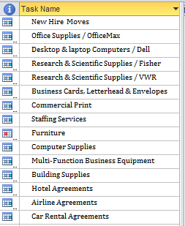
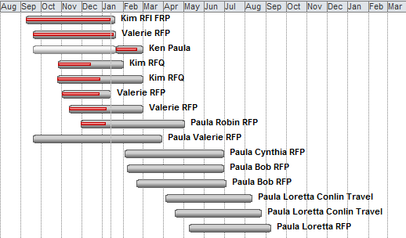
Strategic Sourcing – On Going Projects
We have a number of strategic sourcing initiatives in process, each expected to deliver tangible benefits to the University.
11

